Slide 1
Incentives for GPs and CHWs
December 23, 2010

Slide 2
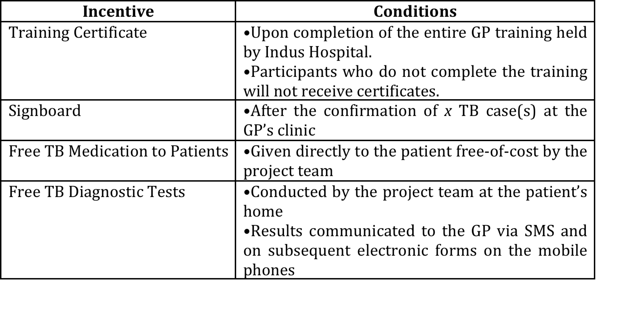
GP: Non-Financial Incentives

Slide 3
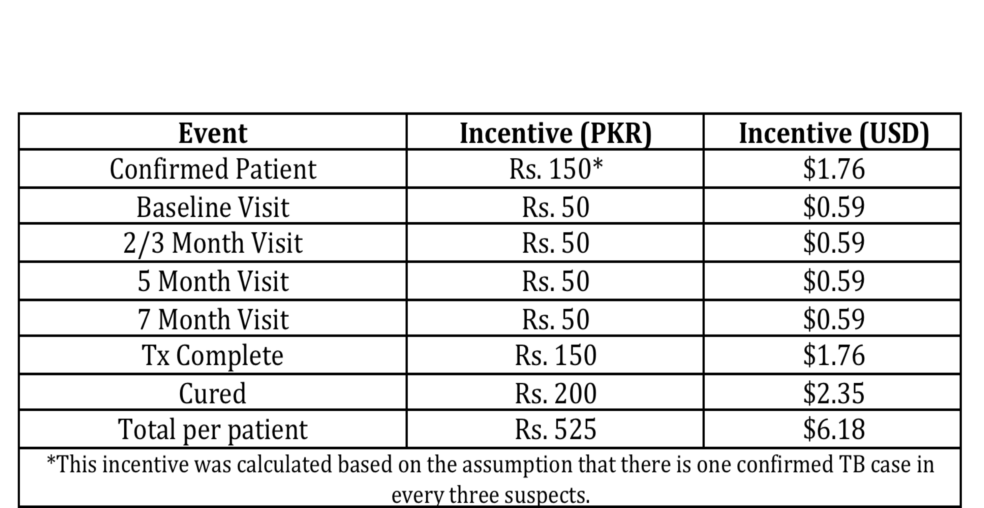
GP: Financial Incentives

Slide 4
CHW: Incentives for Case Detection
Salaries will be based on the number of confirmed cases identified, relative to their peers
The complete salary scale for all CHWs will be determined by the group’s mean performance
Salaries and salary scales will be determined and distributed on a bi-weekly basis
Bonuses will be given to the top performer in a given month and to any outliers who significantly exceed the group’s performance

Slide 5
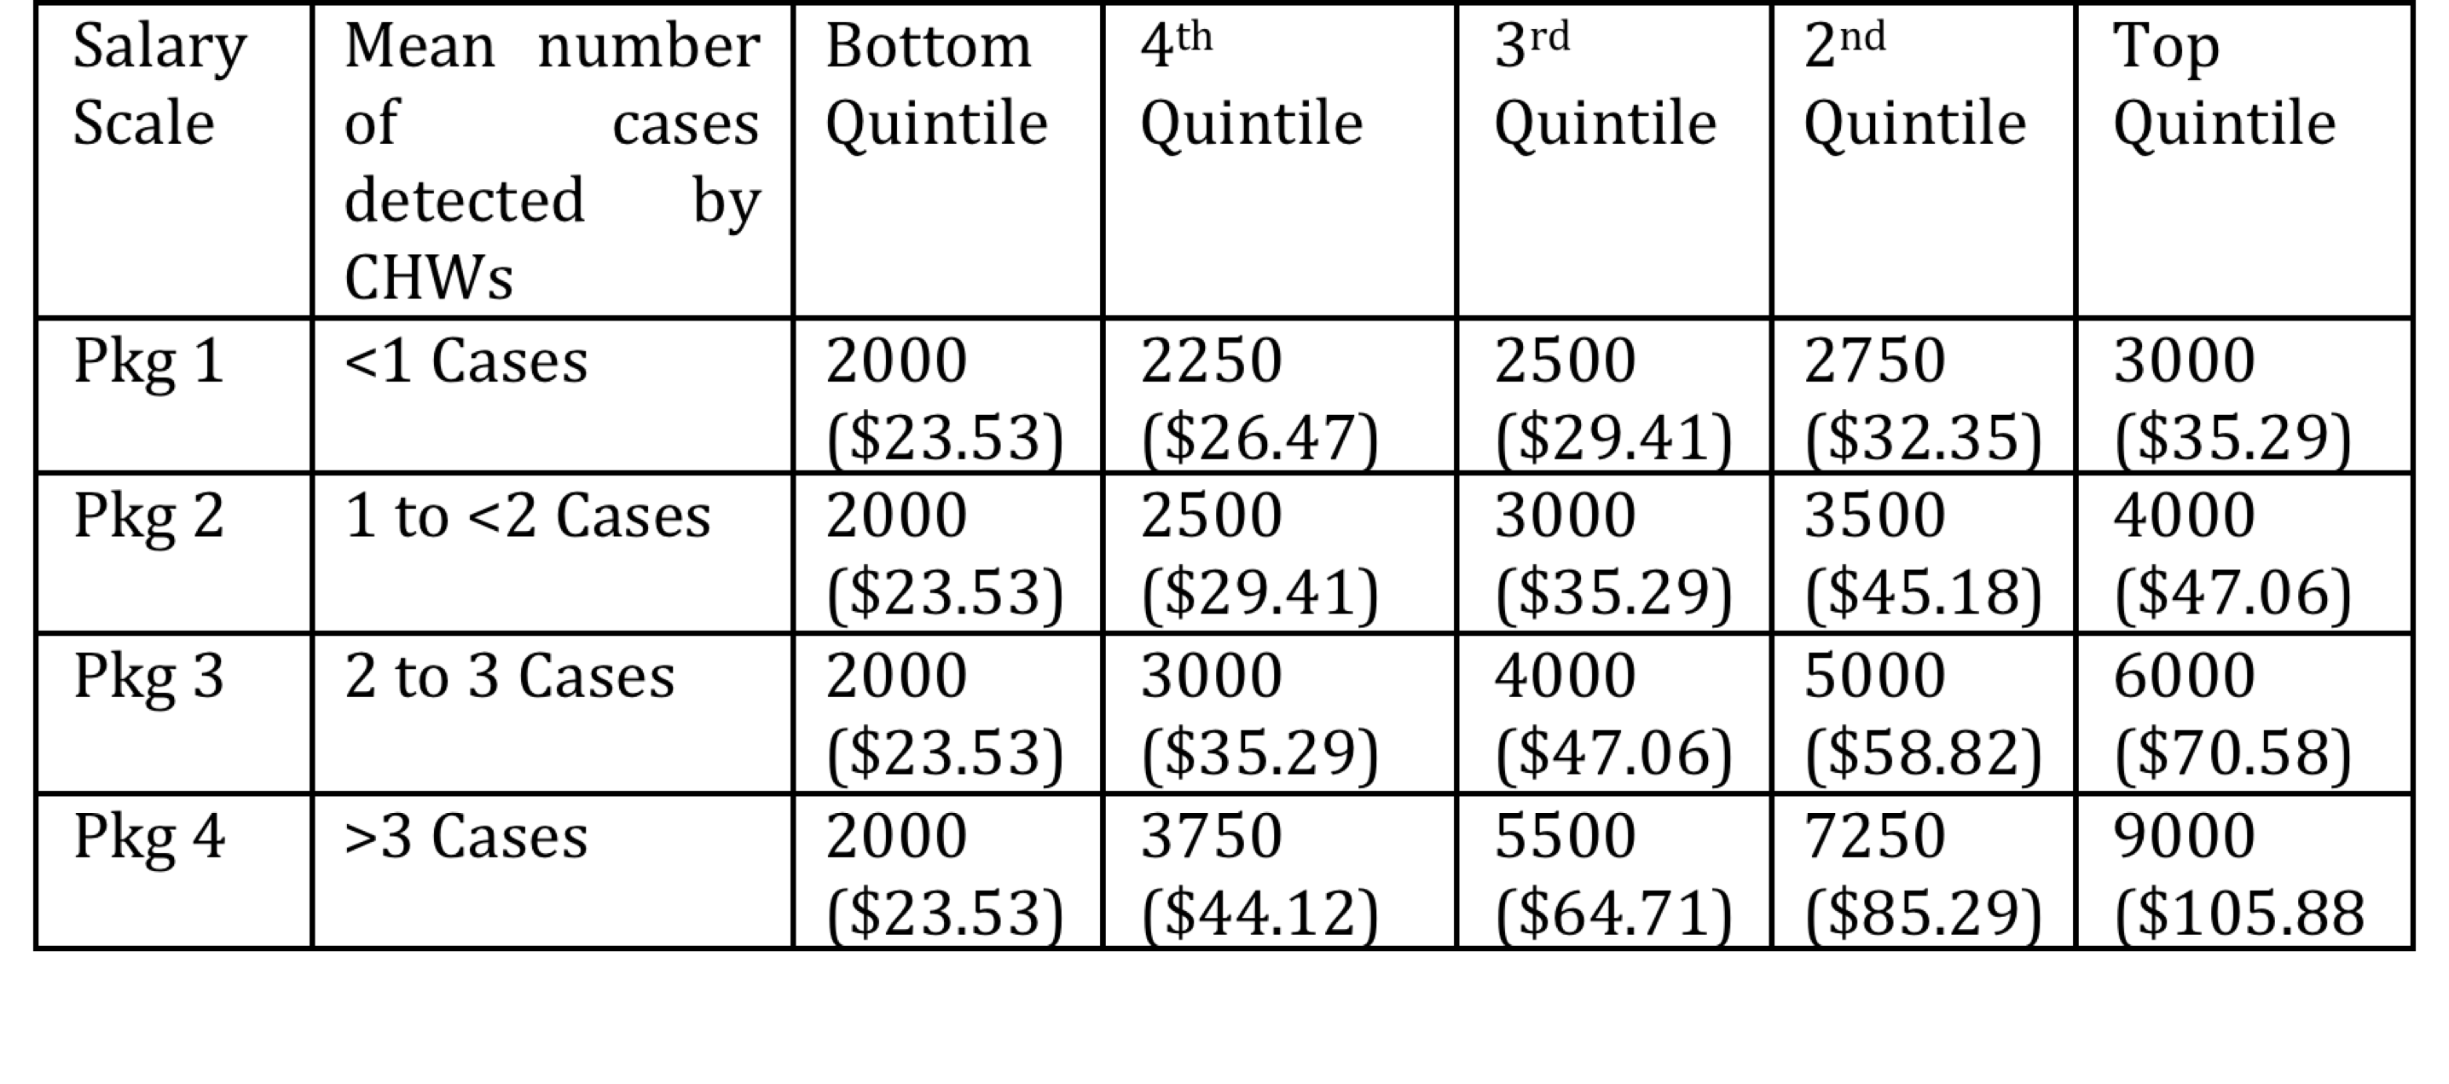
CHWs: Incentives for Case Detection (cont)

Slide 6
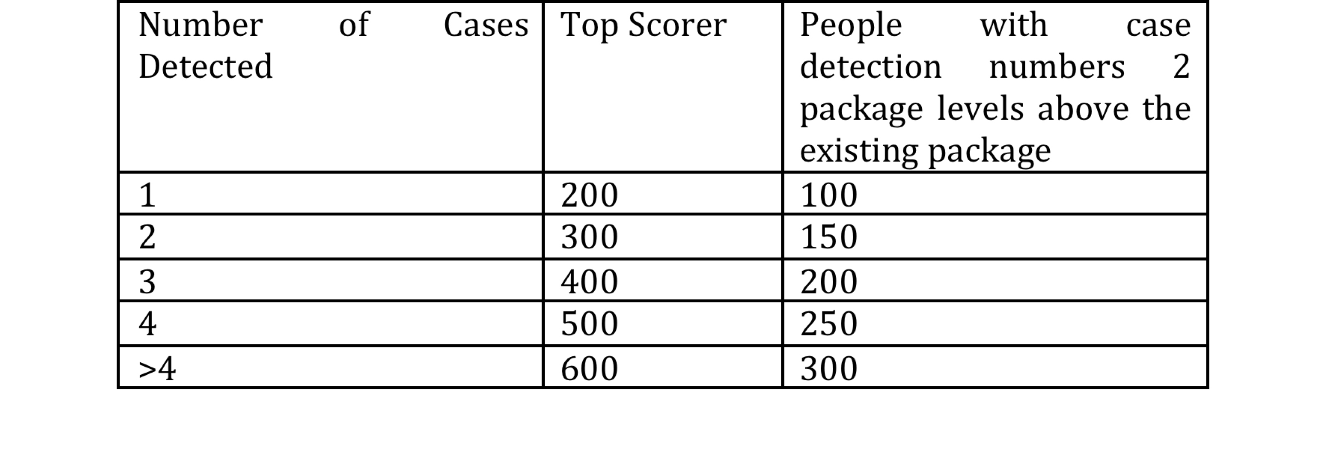
CHWs: Bonuses for Case Detection

Slide 7
CHWs: Incentives for Case Holding

Slide 8
Incentives Delivery: UBL Omni?
Accounts need to be opened at UBL (at branch for Level 2 accounts)
Minimum balance requirements
PKR 500 average over a month
Customers: ATM card costs PKR 250 or 1.5% transaction fee at dukaans
We can open a corporate account (Indus or IRD?) and transfer money through internet banking
Lump sum transaction fees based on volumes

